Slide 1
FELINE SPA
A Cat’s Paradise
Name : Radhika S
Reg No : 727822tucy048
Class : BE-CSE(CS)

Slide 2
CONTENT
01
02
03
04
OUR COMPANY
LANDING PAGE
LOGIN PAGE
HOME PAGE

Slide 3


CONTENT
05
06
CONTACT US PAGE
BOOKING PAGE

Slide 4

OUR COMPANY a private cat grooming website
Our website is dedicated to provide pet owners with all the information they need to keep their furry friends looking and feeling their best. Whether you're a seasoned pet owner or a first-time pet parent, you need to keep your pet healthy, happy, and well-groomed.
We provide services like bathing, brushing, and nail trimming. Our website helps in booking the appointment priorly. It is a cat grooming service that comes to your home and provides well trained groomer.

Slide 5
02
LANDING PAGE
THIS PAGE IS CREATED WITH HELP OF HTML AND CSS.
HTML TAGS USED: h1 , h2 , form , style , button , style,ul,nav,span,
CSS TAGS USED: padding , margin , width , font , background , transition , align.

Slide 6
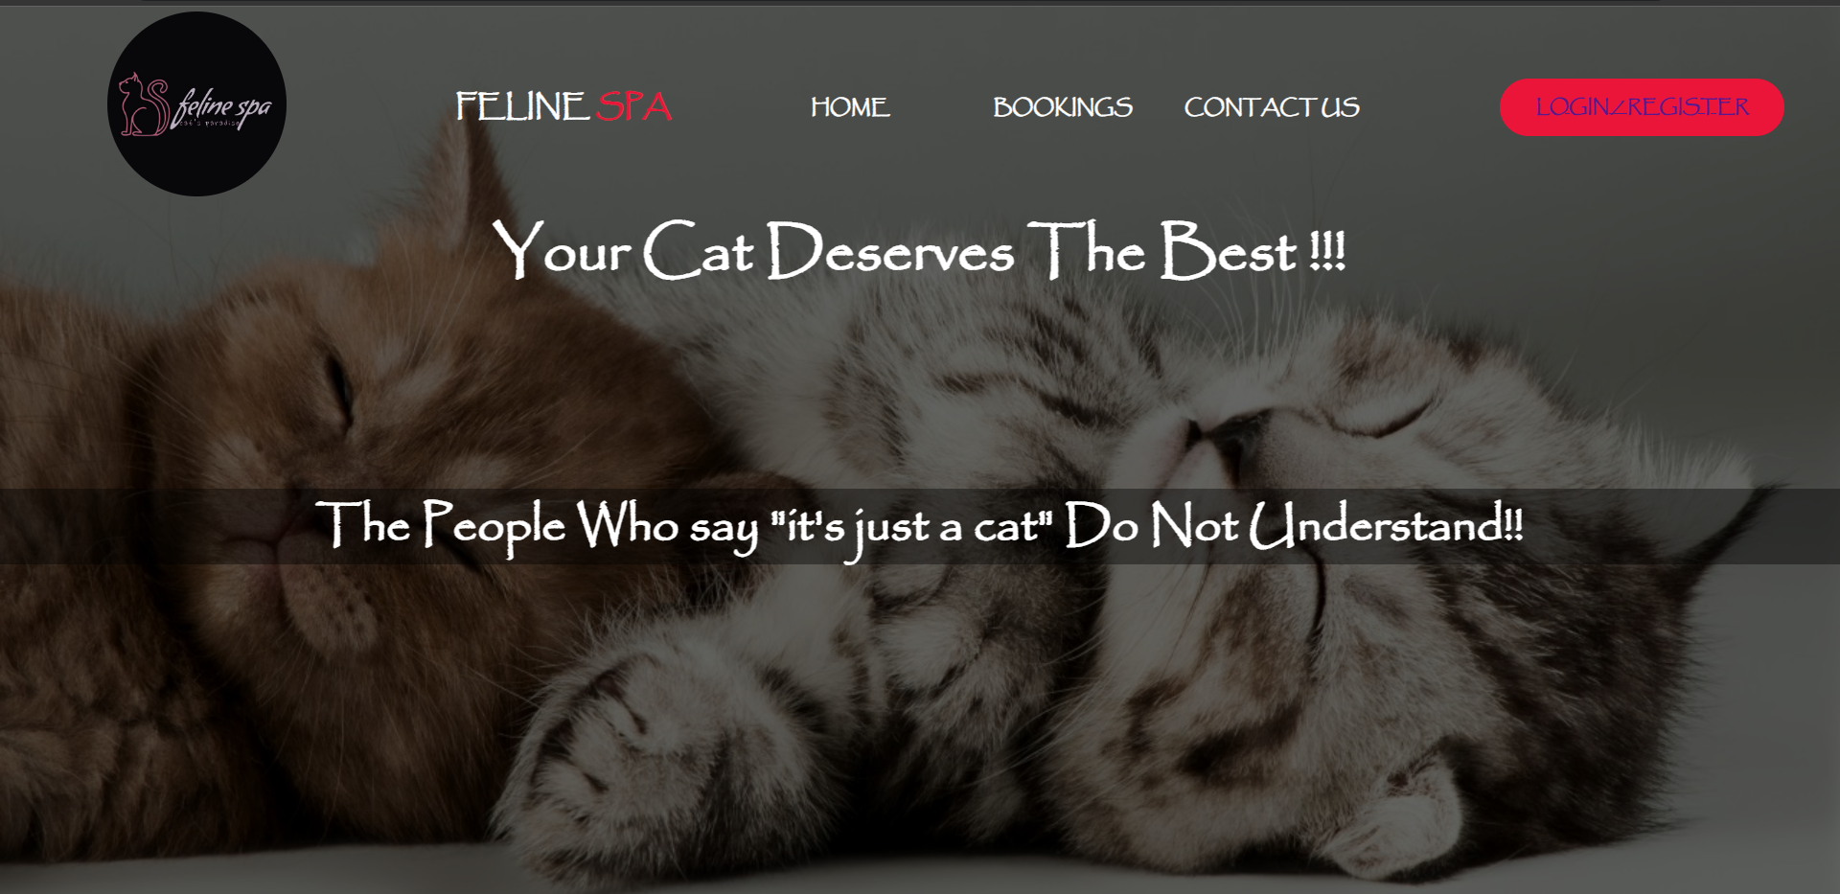

Slide 7
03
LOGIN AND SIGN UP
THIS PAGE IS CREATED WITH HELP OF HTML , CSS .
HTML TAGS USED: h1 , h2 , form , style , button , style
CSS TAGS USED: padding , margin , width , font , background .

Slide 8
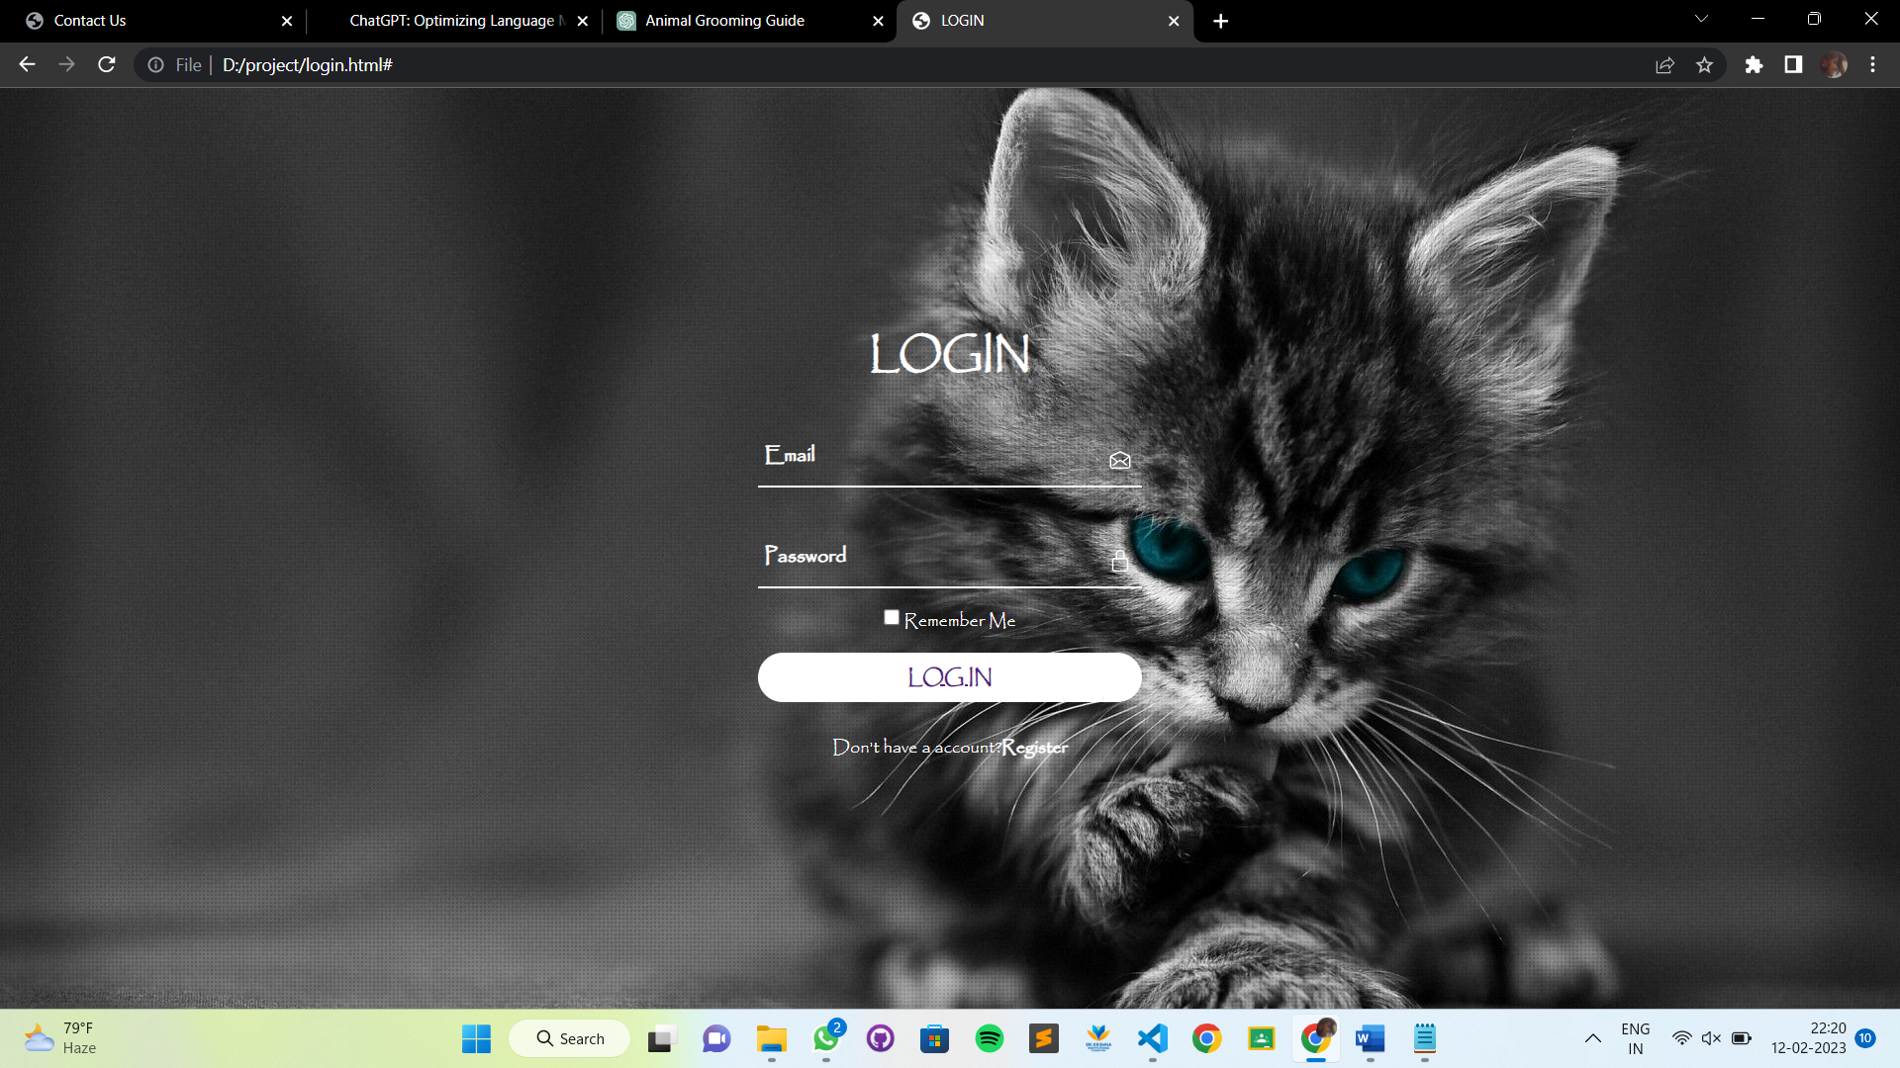

Slide 9
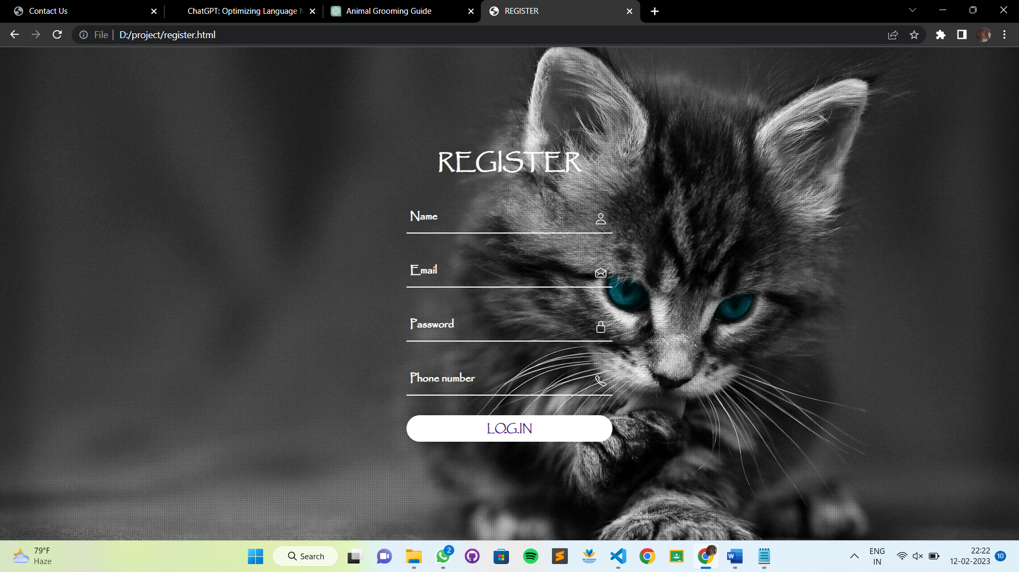

Slide 10
04
HOME PAGE
THIS PAGE IS CREATED WITH HELP OF HTML AND INTERNAL CSS.
HTML TAGS USED: h1 , h2 , form , style , button , style
CSS TAGS USED: padding , margin , width , font , background , cursor .

Slide 11
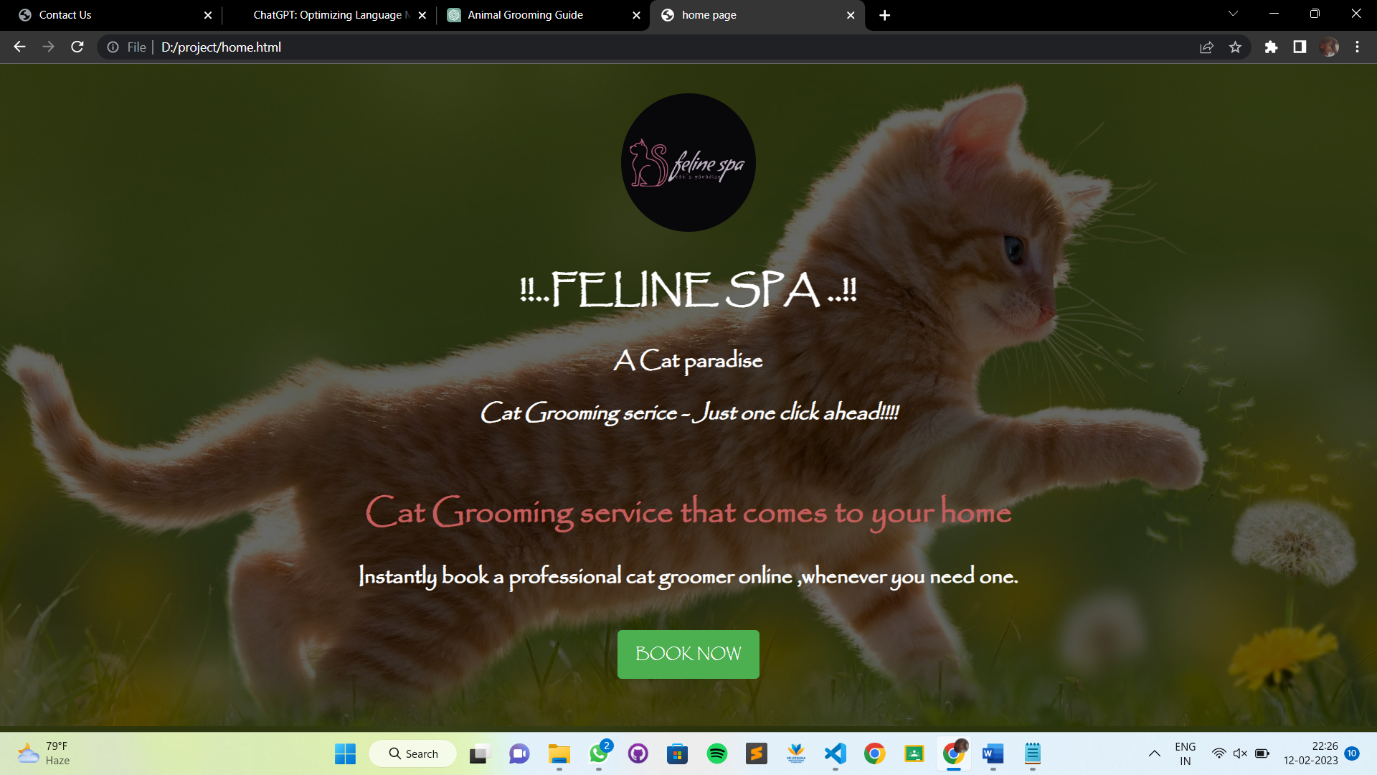

Slide 12
05
BOOKING PAGE
THIS PAGE IS CREATED WITH HELP OF HTML AND CSS.
HTML TAGS USED: h1 , h2 , form , style , button , style , label
CSS TAGS USED: padding , margin , width , font , background , cursor , grid , opacity .

Slide 13
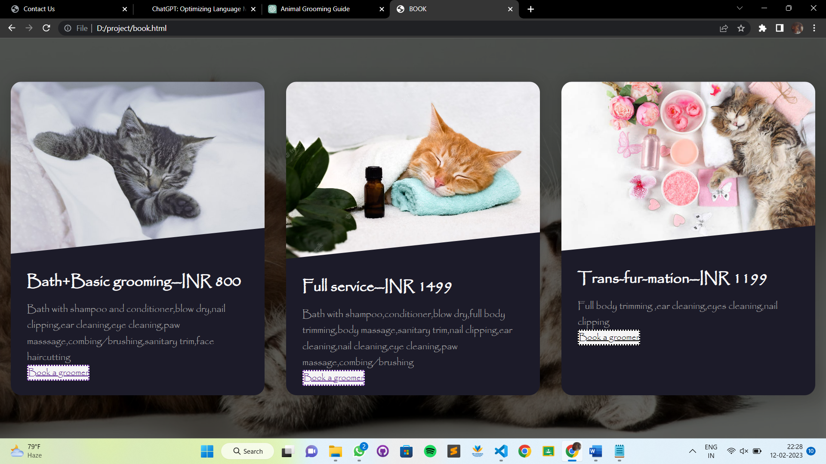

Slide 14
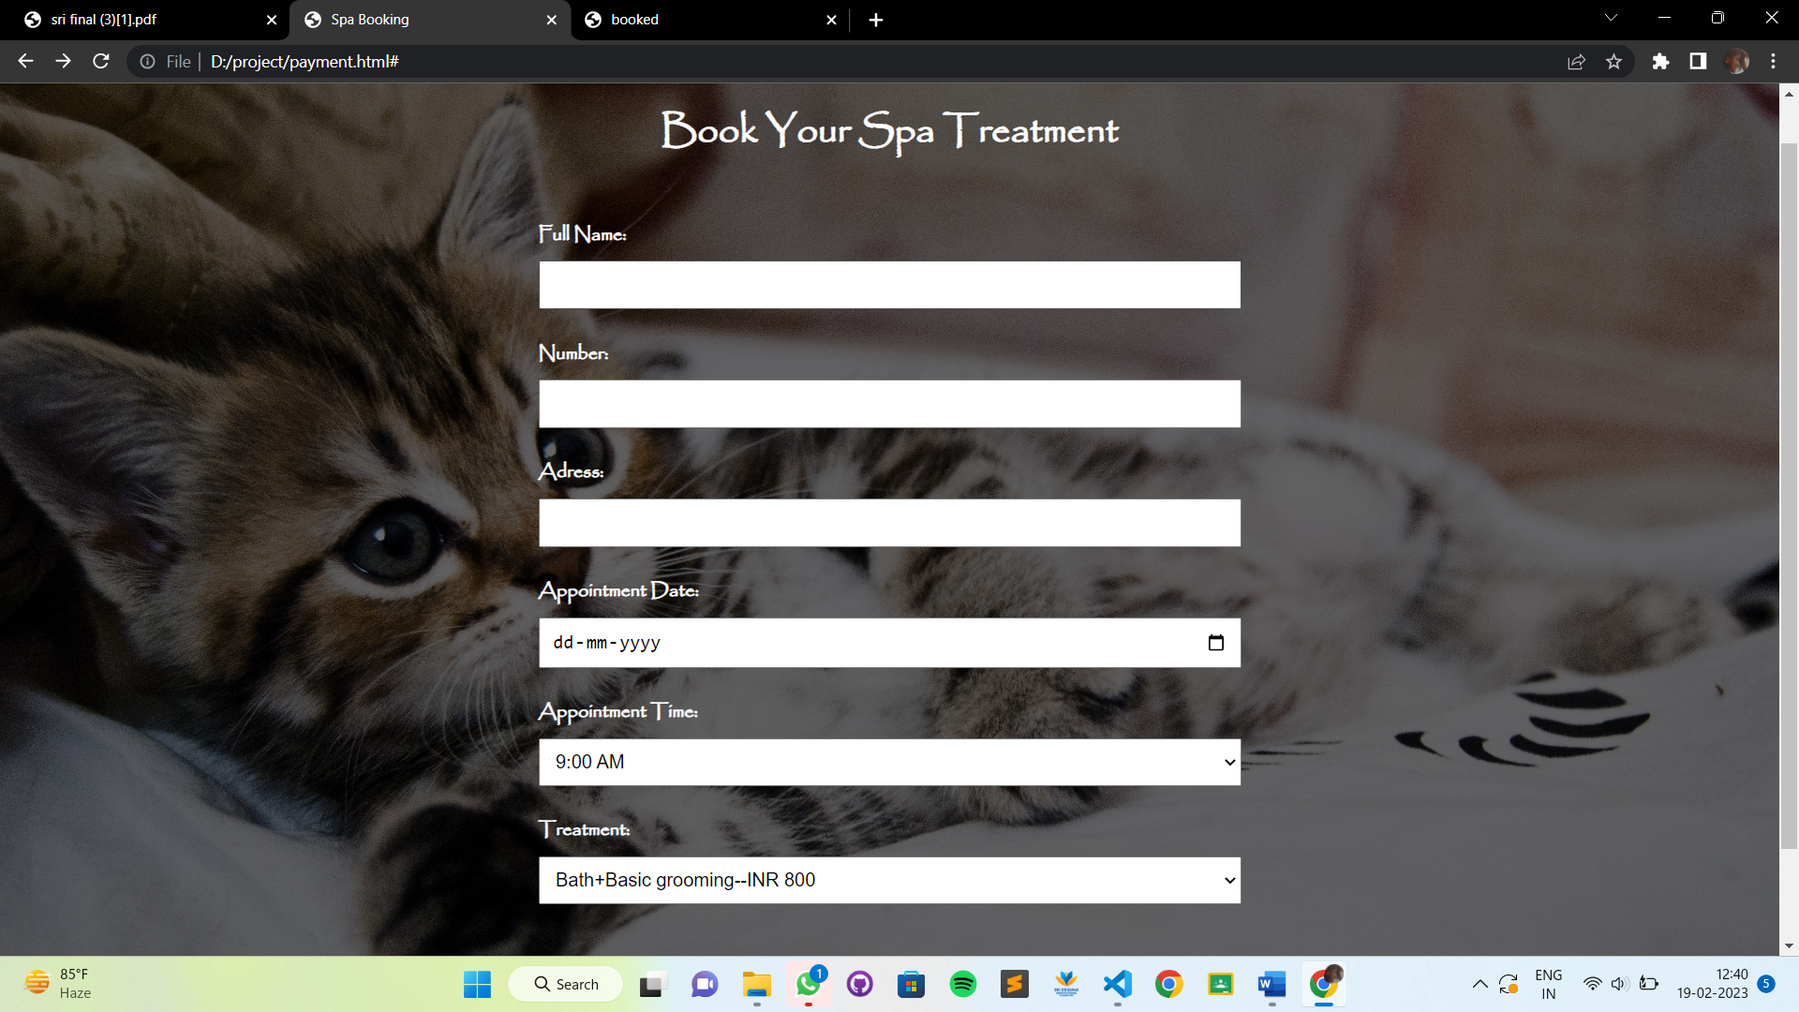

Slide 15
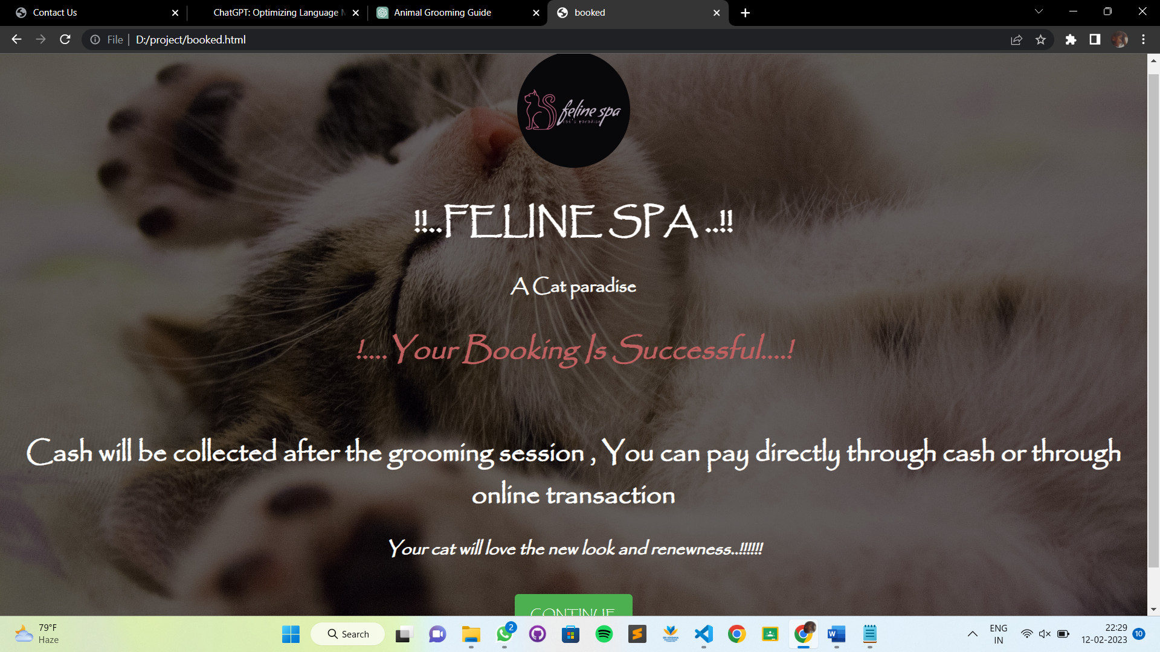

Slide 16
06
CONTACT US PAGE
THIS PAGE IS CREATED WITH HELP OF HTML AND EXTERNAL CSS.
HTML TAGS USED: h1 , h2 , form , style , button , style , table
CSS TAGS USED: padding , margin , width , font , background , cursor , opacity , align , outline , transition.

Slide 17
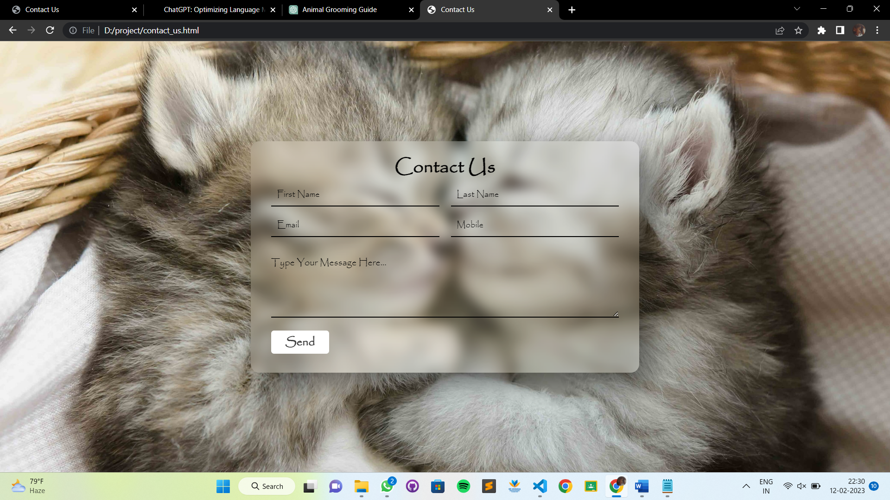

Slide 18
THANK YOU!

